Slide 1
Language Learning x Needfinding
Global Grand Challenges - Team 4

Slide 2
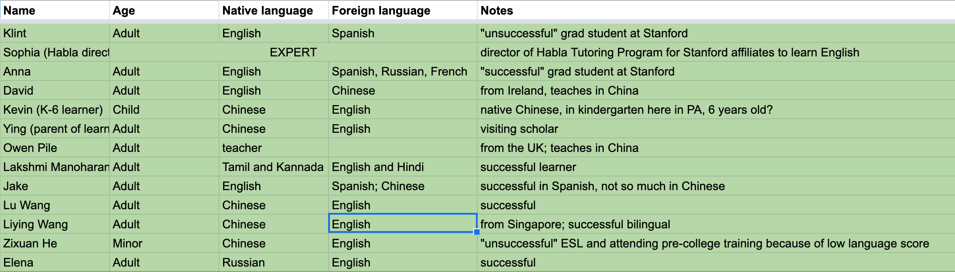
13 Interviews
We spoke to a mix of people with different language learning experiences, some successful and some unsuccessful, and a range of people with English as a native or foreign language.

Slide 3
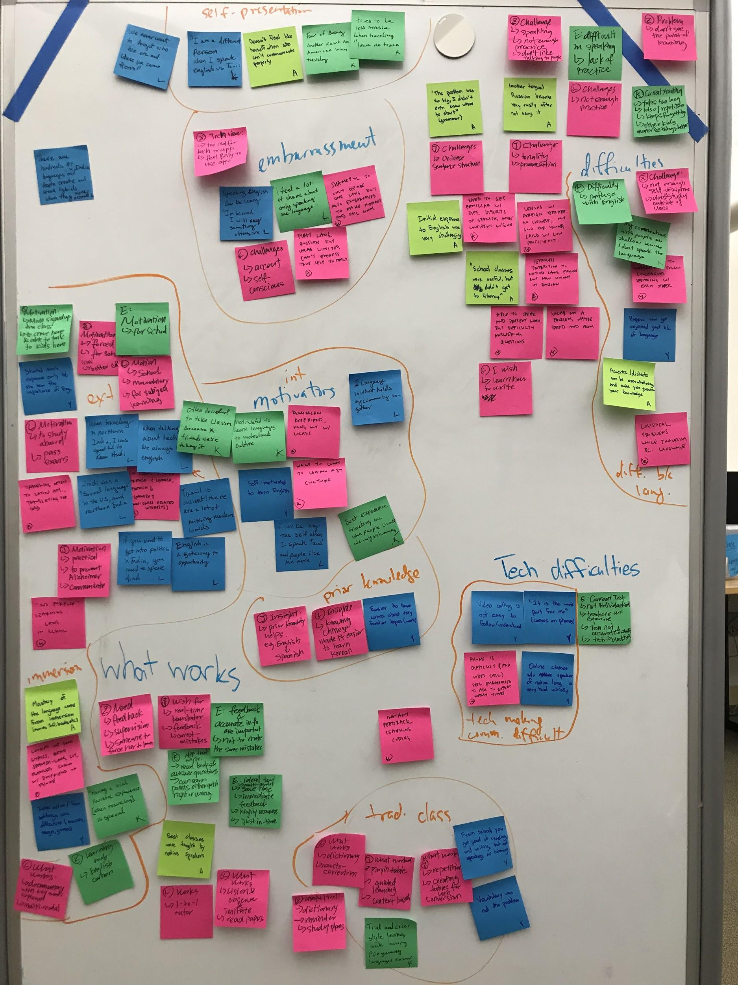
Affinity Mapping
Themes: self-presentation, embarrassment, difficulties in learning languages, difficulties caused by language, technology making communication difficult, culture, intrinsic motivation, extrinsic motivation, immersion, prior knowledge, traditional classes, and what works.

Slide 4
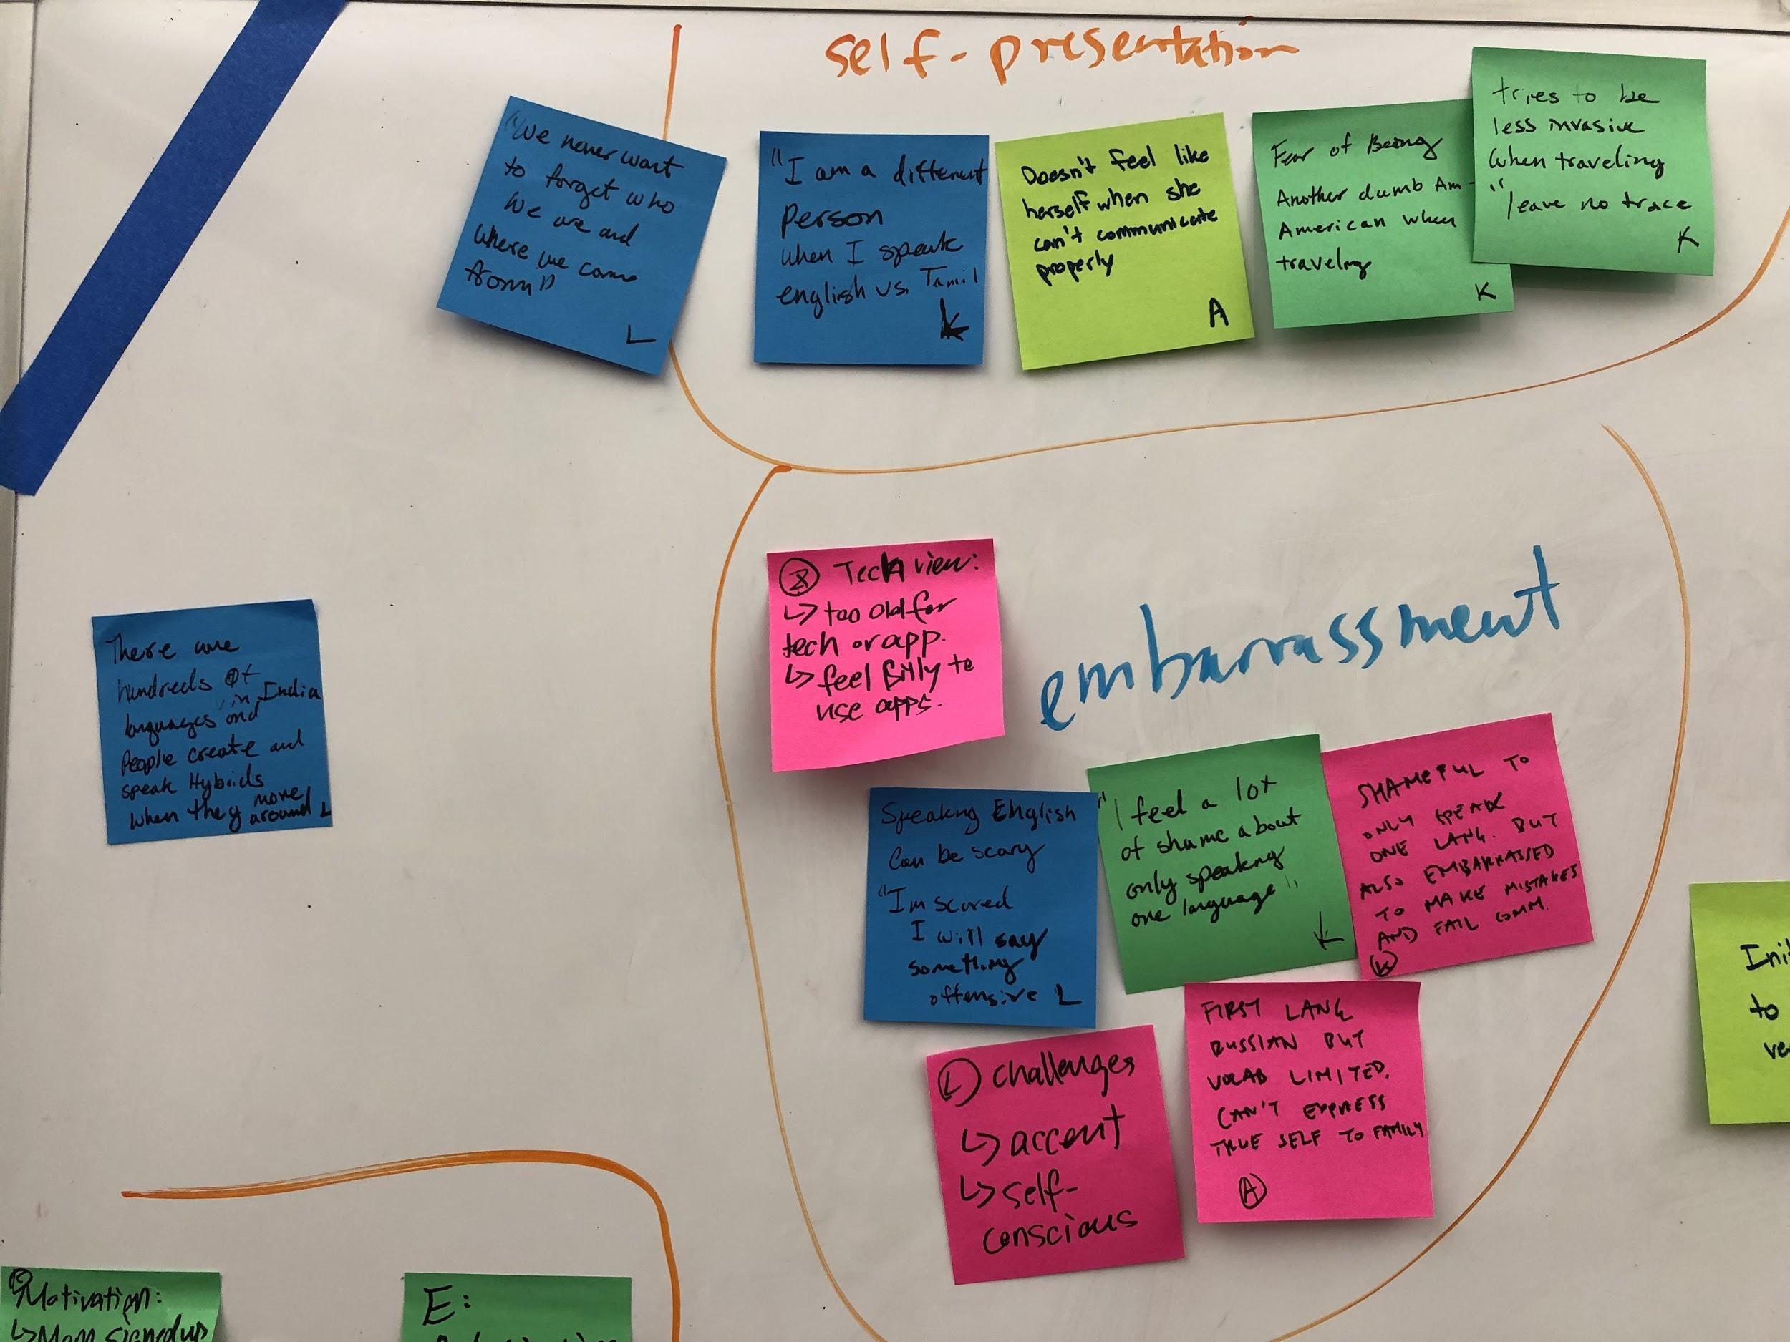
Embarrassment

Slide 5
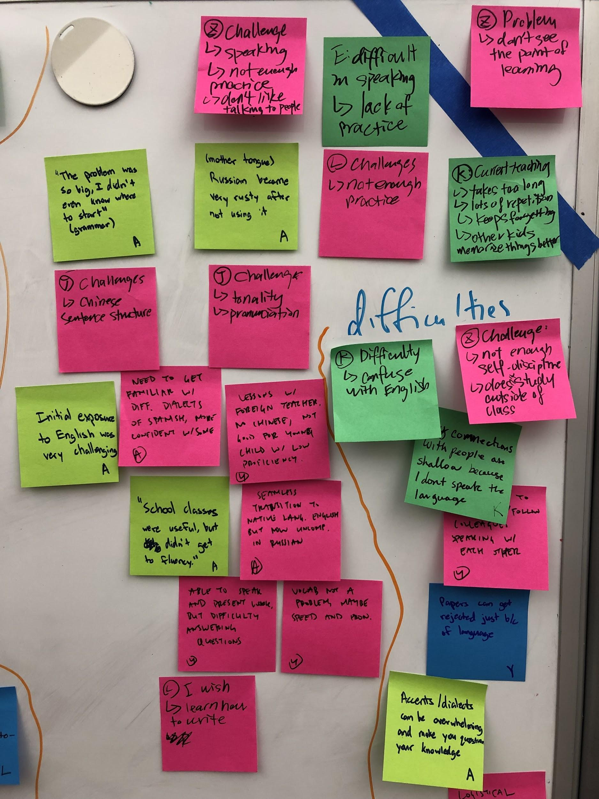
Difficulty

Slide 6
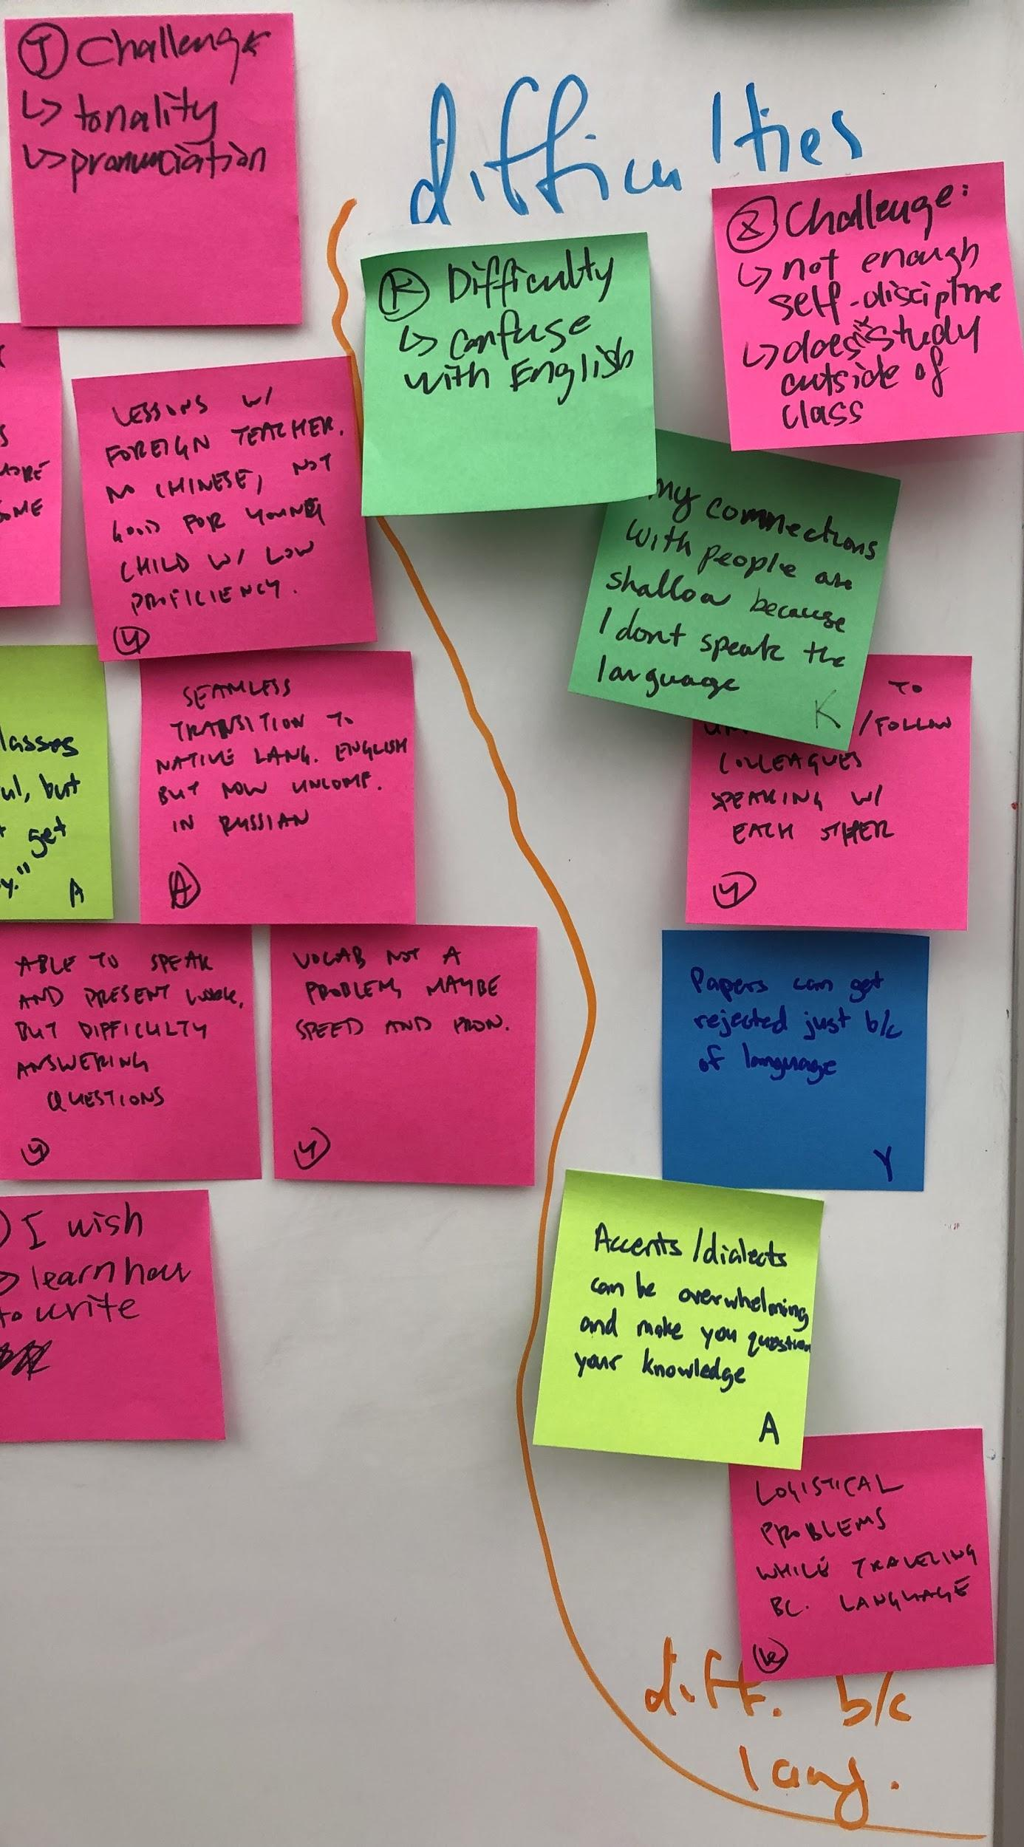
Difficulty due to language

Slide 7
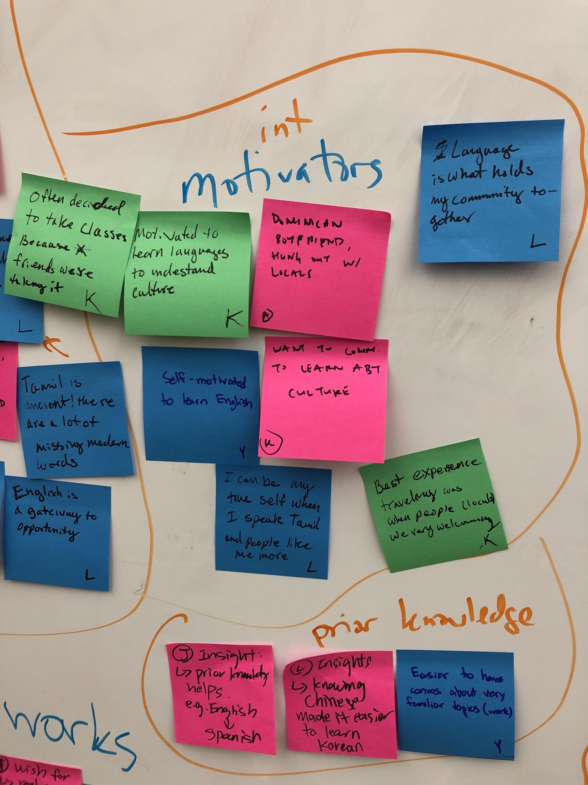
Intrinsic Motivations

Slide 8
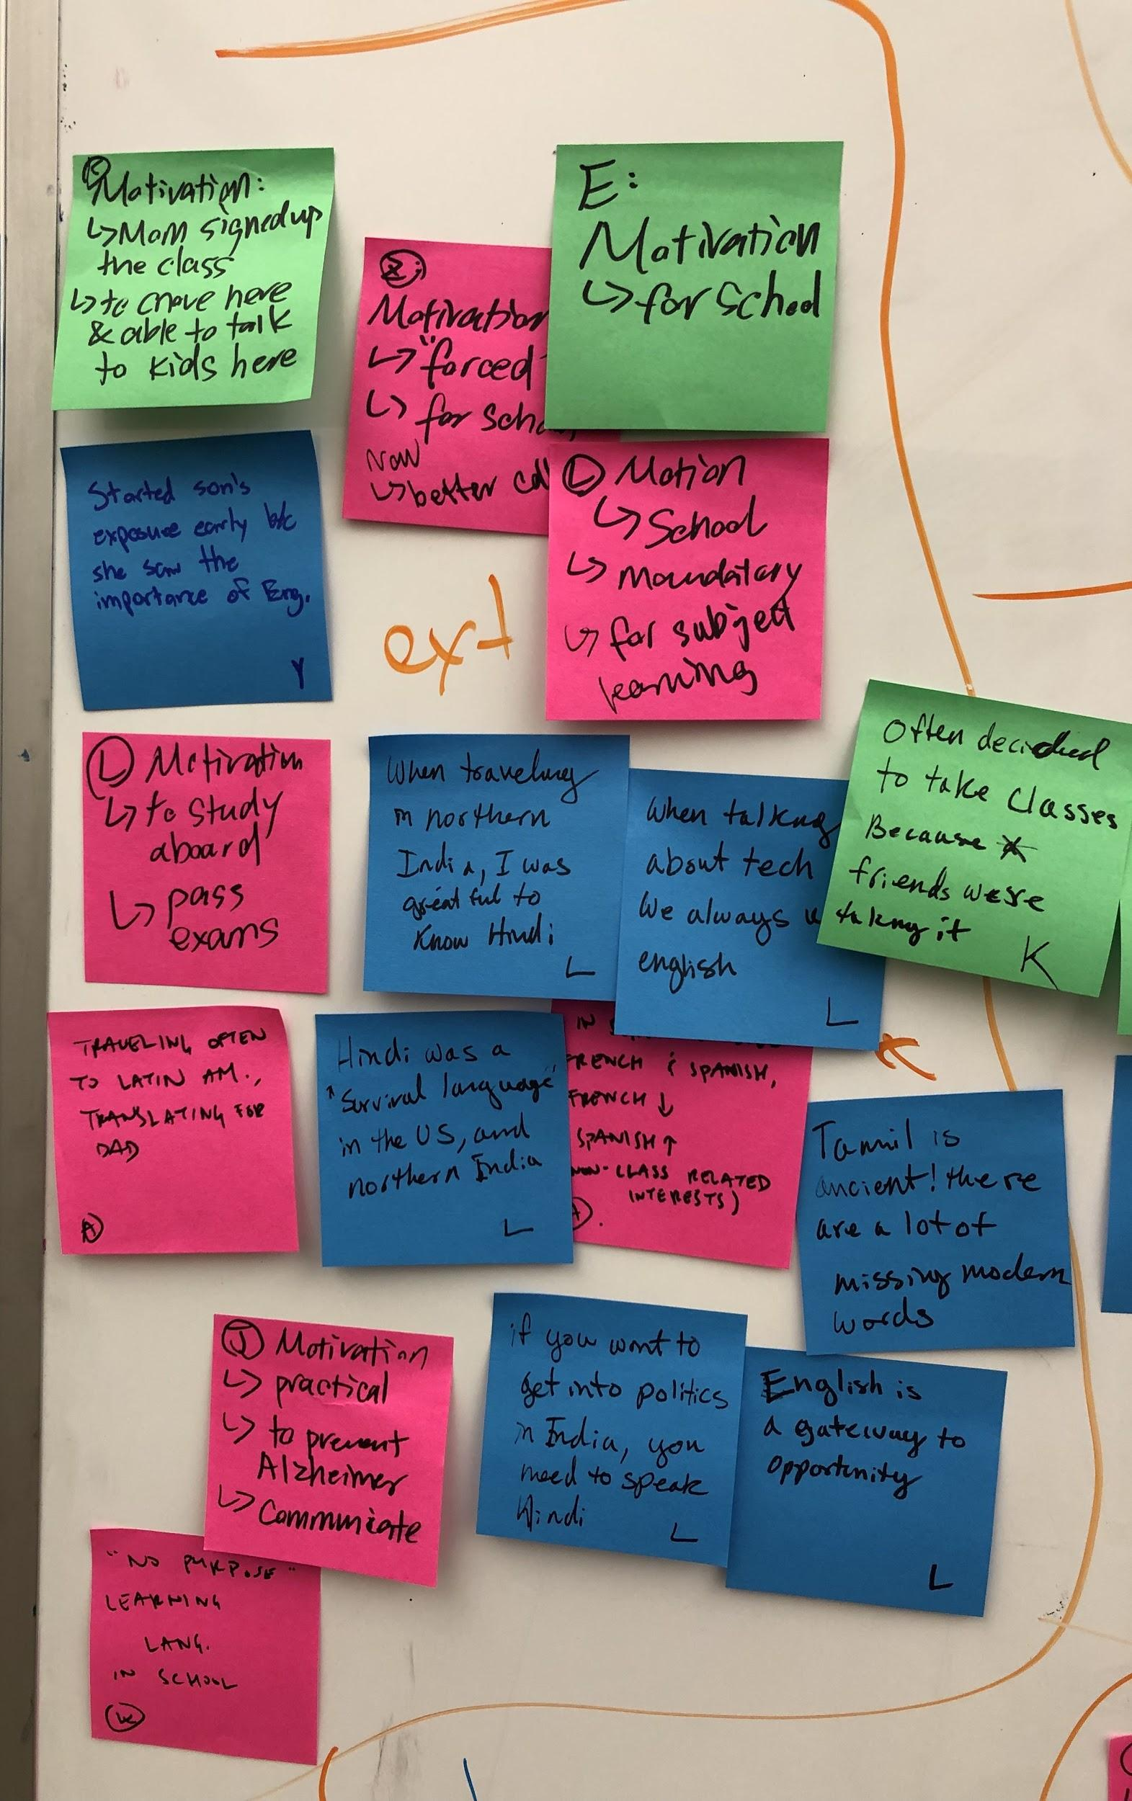
Extrinsic Motivations

Slide 9
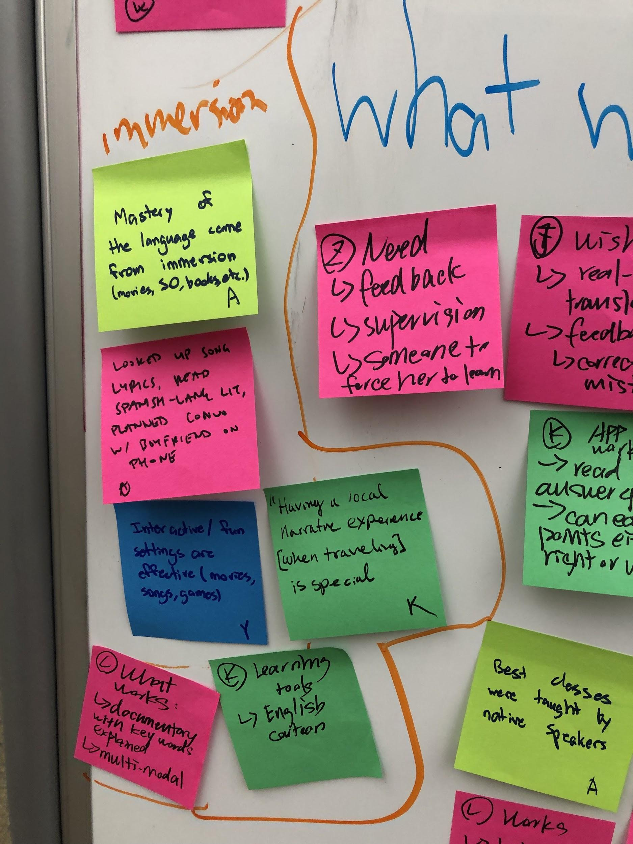
Immersion

Slide 10
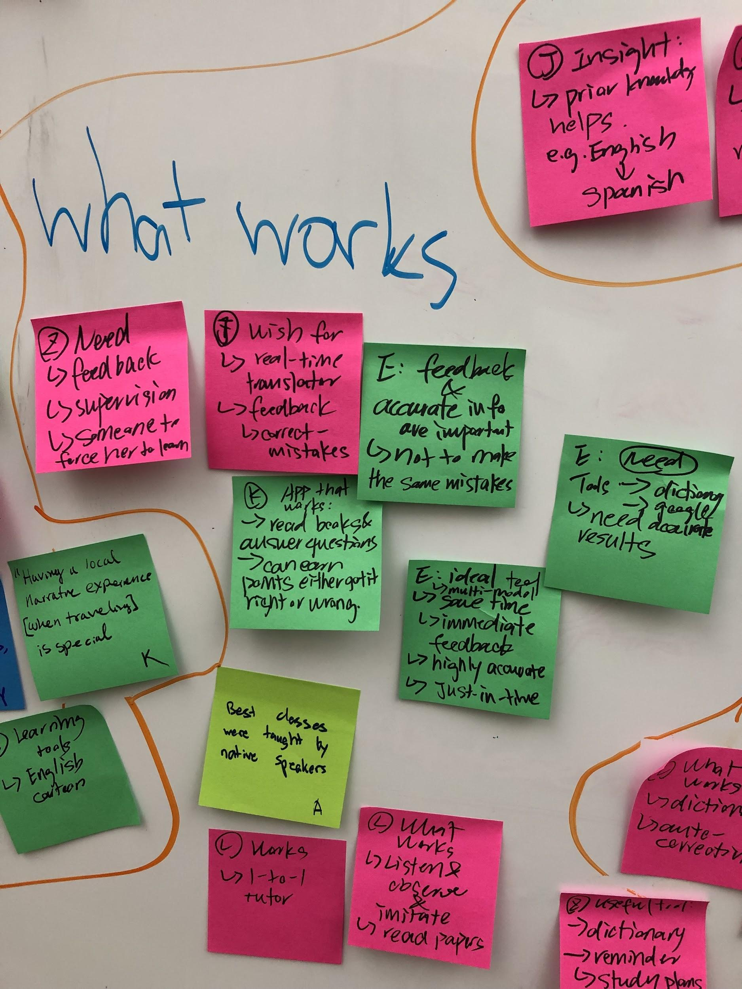
What works

Slide 11
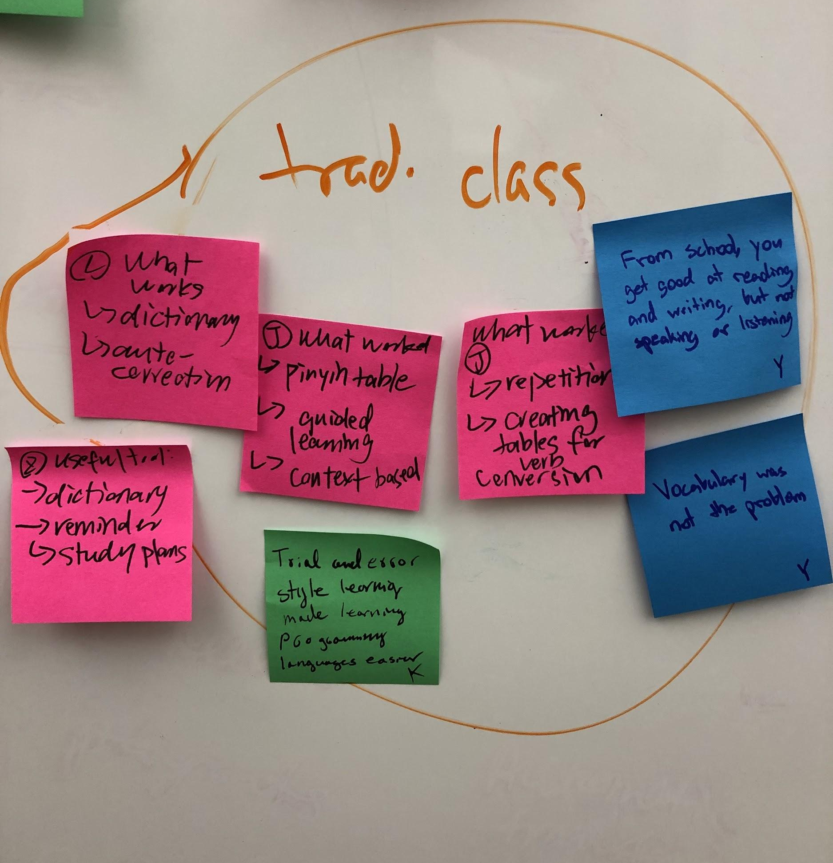
Traditional Class/Teaching

Slide 12

Anna’s Language Learning Journey
Successful learner
0-7 years
7-14 years
14-20 years
20+ years
Russian
Moved to London
Started going to Dominican Republic
English
Spanish
Started dating Chilean boyfriend
French
Hindi
Started taking French and Spanish
Relearned French in case of moving to Haiti
Learned Hindi for work
Nervous and shy getting adjusted to London (moved from Russia when she was 3)
Spanish felt more exotic and appealing than French
Genuinely interested in the Spanish culture
Uncomfortable when with Chileans because of their different way of speaking
Feel
Spoke Russian when at home with parents and English everywhere else
Took Spanish and French classes in school
Immersed herself in the Spanish culture to better engage with her boyfriend
Tries to only talk in Spanish to her boyfriend once a week
Do
Think
Do I really fit in?
Very uncertain about her Russian despite doing very well on the national exam
Sometimes nervous about speaking Spanish
People could mistake her as a native Spanish speaker
“The gap in my [Russian grammar] was so big, I didn’t know where to start”
“Classes were useful, but didn’t get me to the point of fluency”
dddd
Say
“I still remember not knowing how to write my name in English and feeling very frustrated.”
“I don’t feel like my grandparents really know who I am”
Key Insights
True mastery of Spanish came from full immersion
Using a language in real world settings is very engaging
The best classes were taught by native speakers

Slide 13
Klint’s Language Learning Journey
Unsuccessful learner
“I am very monolingual”
Emotional energy
Early life
High school
Undergrad
Present
Learning Japanese
Traveling internationally with no foreign language skills
Forced to learn
Spanish at a community college with people 2-3 times his age
Learning Italian
Successfully trades traditional languages for programming ones
Touchpoints
Painpoints
Didn’t feel like he belonged in the class.
Started off trying really hard, but didn’t have a knowledgeable teacher and therefore didn’t have a meaningful outcome.
Coding languages can be used to build useful things, unlike traditional languages
Having a local narrative experience made trips very special
Feel
Muddled through the 2 week class without really learning anything
Struggled to make meaningful connections with people while traveling
Do
Took Japanese and spanish because a bunch of friends were also taking it, wasn’t motivated.
Convinced his advisor to count C++ and FORTRAN as a foreign language
Think
Never had any exposure to other languages before this class, no family members that spoke other languages
“I feel like speaking only one language is a very shameful thing”
I've always been motivated to learn language because of culture, but didn’t care about memorization of vocabulary
“Trial and error nature” of learning coding languages works better because the feedback is instant
Say
“I had never met a Japanese person at this point in my life” .. it felt very pointless
When trying to learn how to do something, always look on Youtube first, find tutorials and instructional videos
“Every time I'm in another culture, I wish I could speak another language and not be another dumb American”
“I got frustrated when I couldn’t communicate…” “I learned “Taco Bell” level Spanish”
Insights
Studying language without also studying culture can make the experience seem pointless
Learning in sub-par environments can whittle away at motivation
Goals outside of the learning objective itself, (i.e. being able to build connections with people, accomplish real world goals) builds motivation
Notes:
as a child 6-7 language immersion program at local community college, 2 weeks long, didn’t like it, didn’t learn much

Slide 14
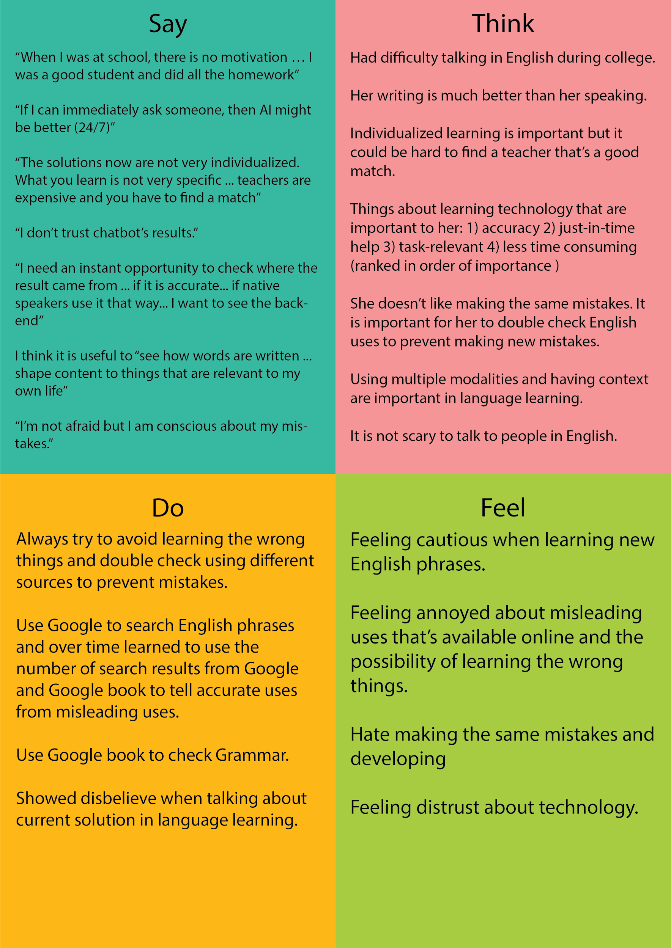
Notes:
Insights:
Previous learning was driven by external motivations;
the need for accurate feedback;
The need for context to make learning meaningful;

Slide 15
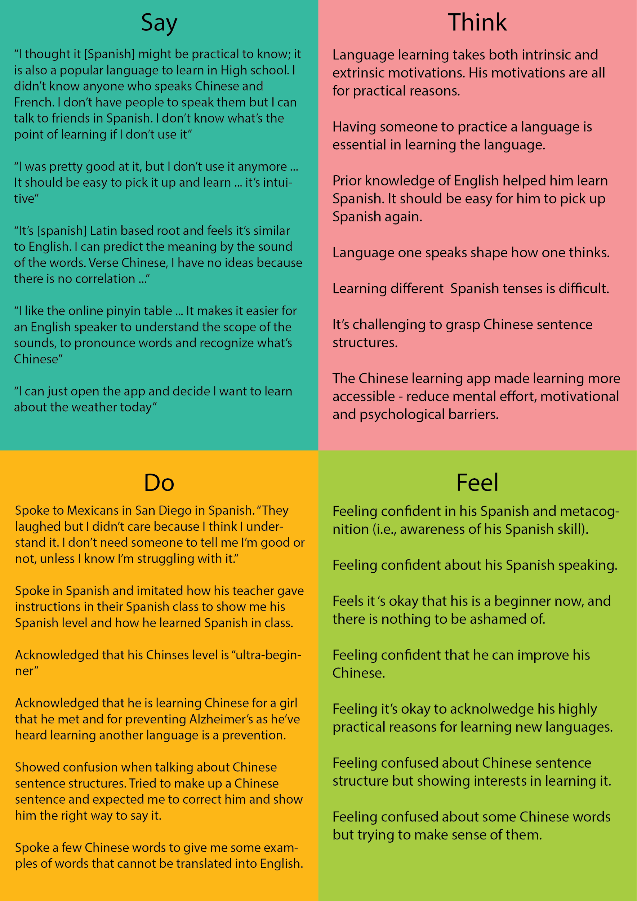
Notes:
Insights:
Learning was driven by external motivations;
the need for practice;
Prior knowledge of English helps learn Spanish;

Slide 16
Insights, Contradictions, Surprises
Need for a strong purpose to successfully learn a language, but intrinsic and extrinsic motivators can both be effective
For learning English, extrinsic
For learning non-English (native English speaker), intrinsic
Language as a potential source of shame: failing to speak a heritage language well, not being able to communicate in a foreign language
“I don’t feel like my grandparents really know who I am” -- Anna
“I feel a lot of shame about only speaking one language” -- Klint
Can be embarrassing to make mistakes or fail in communicating (especially speaking), so may avoid opportunities despite interest
Desire to be able to speak a language but not putting in efforts to learn
Different self-presentation depending on the language, able to explore different facets of self

